Slide 1
人工智能技术在脑机接口中的应用 AI in BCI
介绍人：
黄尚民、张致远、张杭磊、何鋆林、王凯灵
2022.7.12

Slide 2
1
数据处理
2
SVM介绍与应用
3
HDL案例与分析
4
补充介绍（MFCC）
2

Slide 3
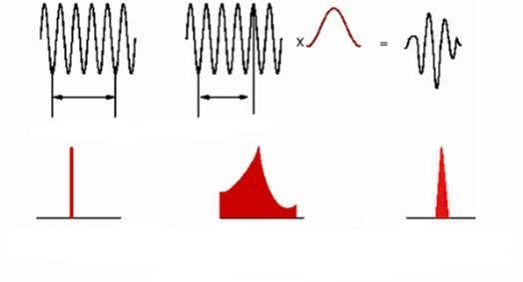
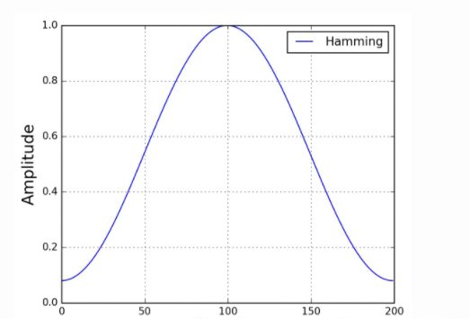
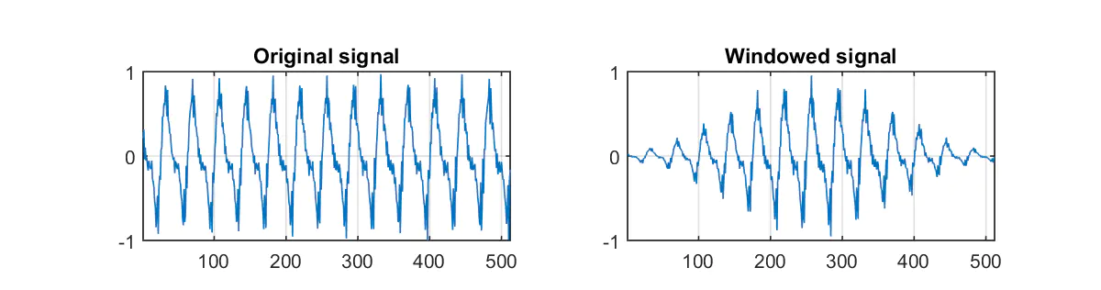
MFCC(Mel Frequency Cepstral Coefficient)
Pre-emphasis and frame-windowing
Enhance the energy of high frequency signals to prepare for Fourier transform
Framing to preserve timing information
There should be 50% overlapping part between adjacent frames
Windowing to make it smooth
+
3
Notes:
梅尔倒谱系数

Slide 4
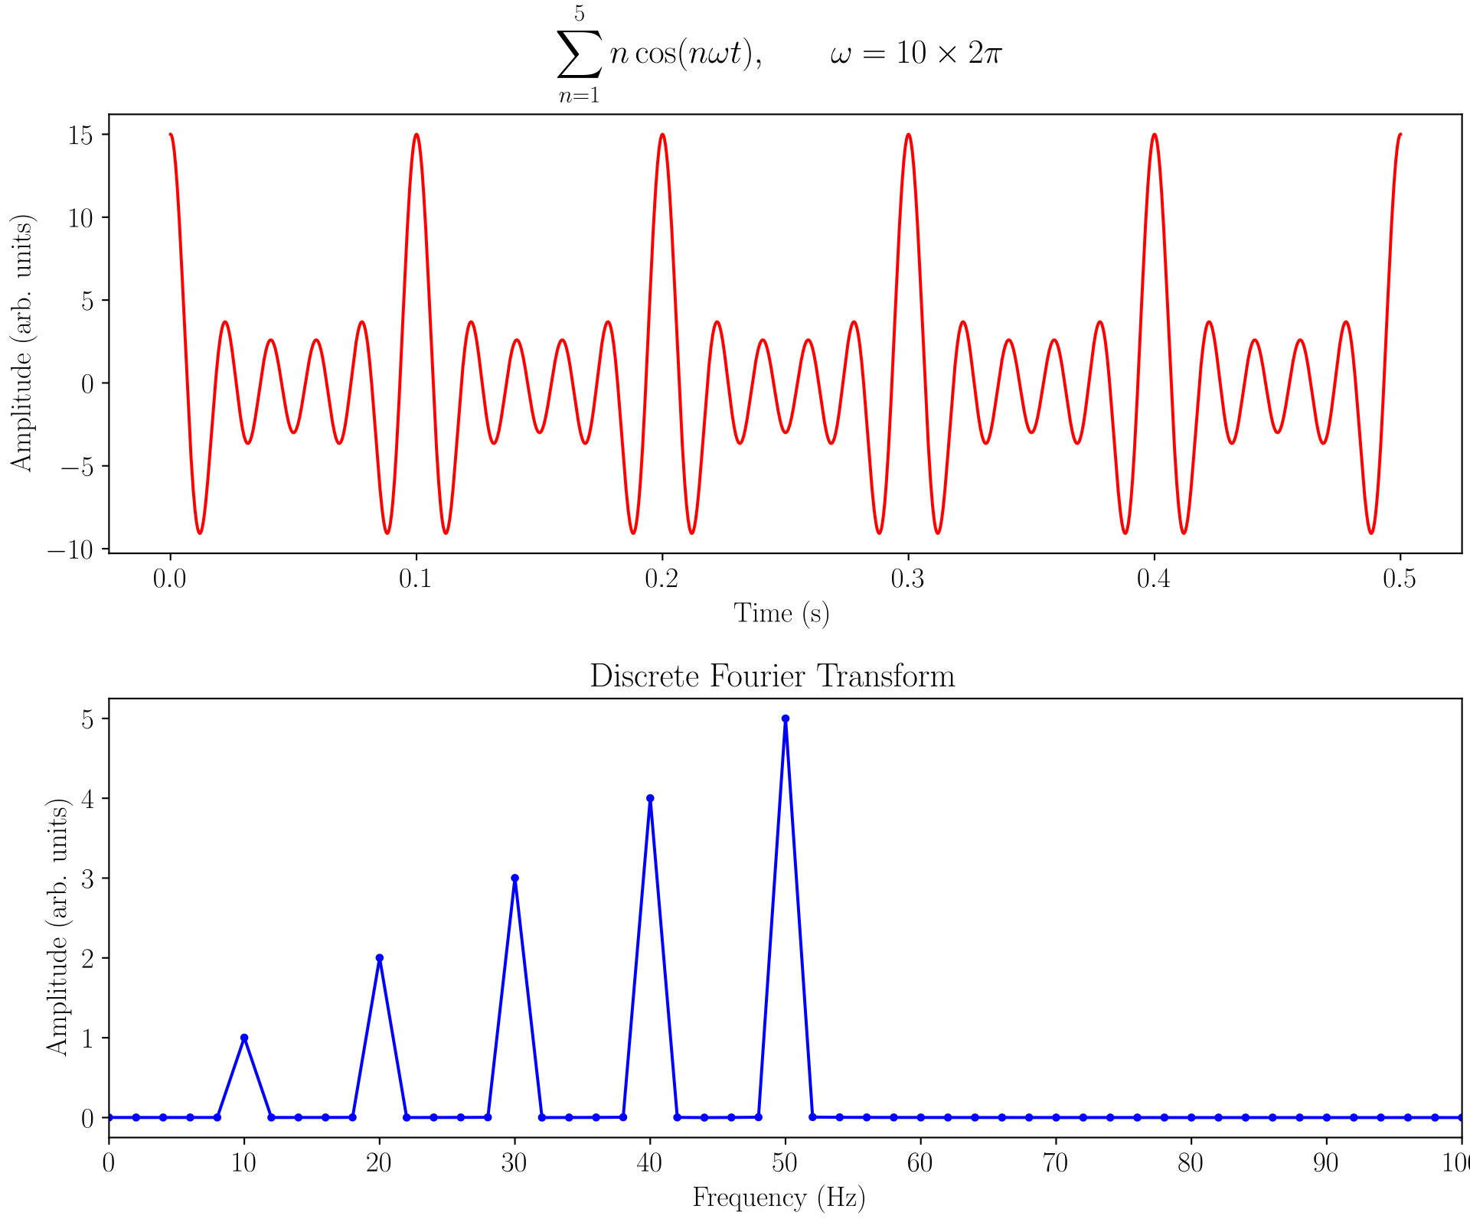
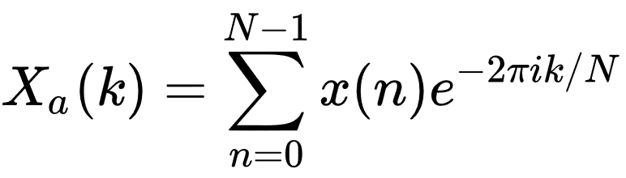
MFCC(Mel Frequency Cepstral Coefficient)
Pre-emphasis and frame-windowing
FFT
4

Slide 5
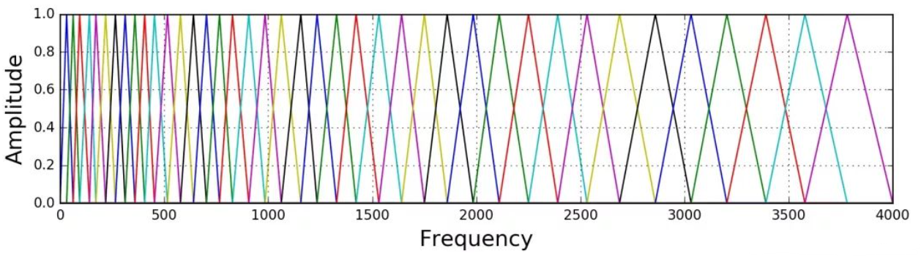
MFCC(Mel Frequency Cepstral Coefficient)
Pre-emphasis and frame-windowing
FFT
Mel Filter Banks
5
Notes:
梅尔倒谱系数

Slide 6
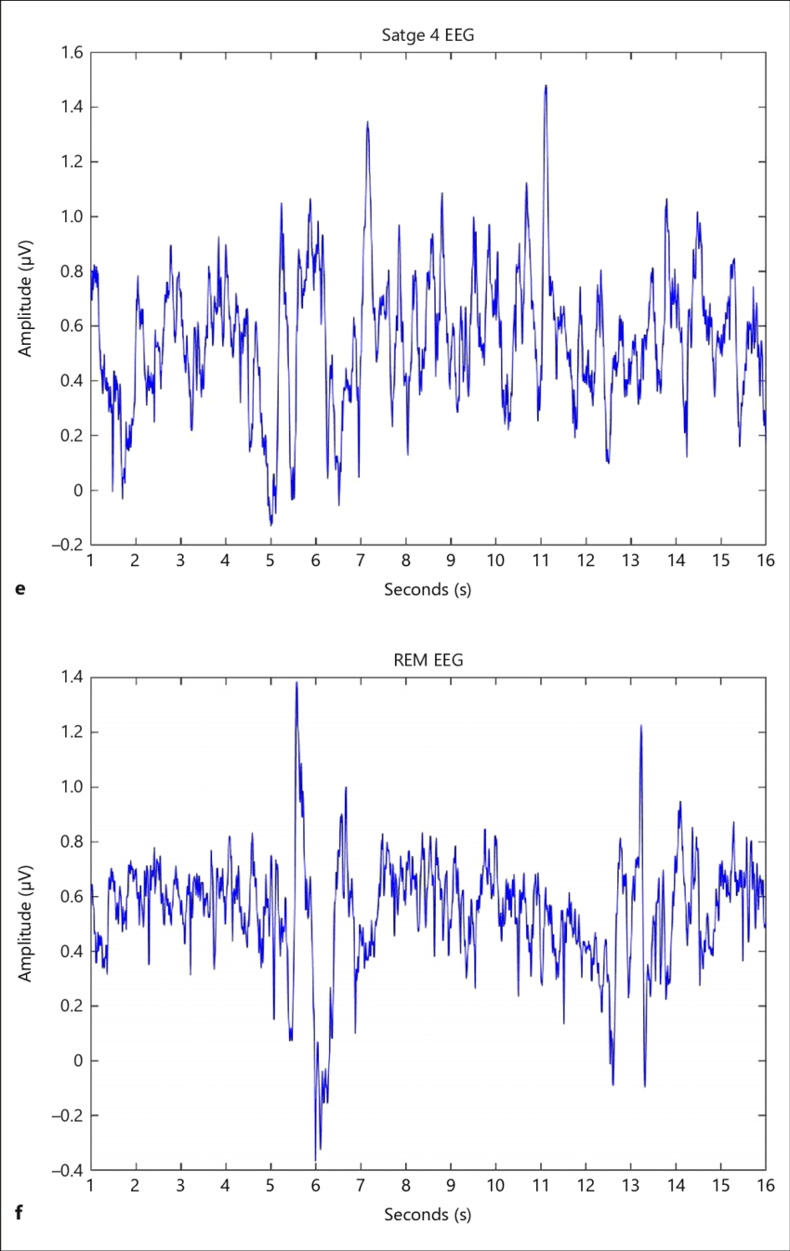
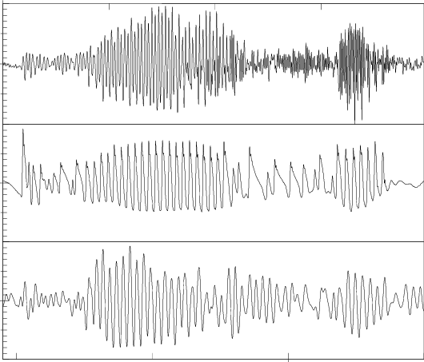
MFCC
Raw EEG
Raw voice signal
6

Slide 7
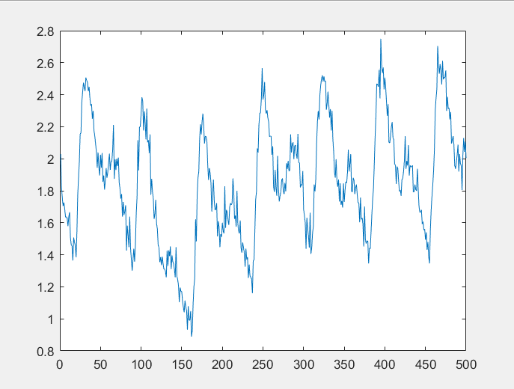
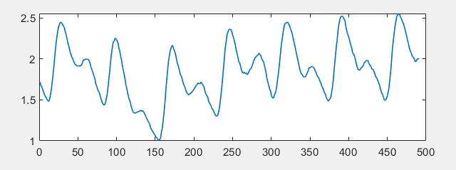
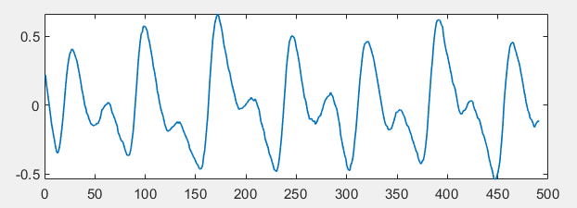
Complete Process
Project Achievement
Get a signal with high signal-to-noise ratio
Preprocess
Polynomial fitting
CWT
filtered
Correct
Baseline Drift
Remove noises
<0.3Hz or >10Hz
Correct wandering
baseline
Get a signal with high signal-to-noise ratio
7

Slide 8
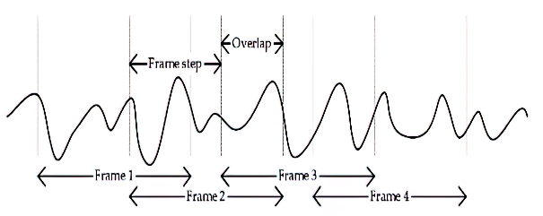
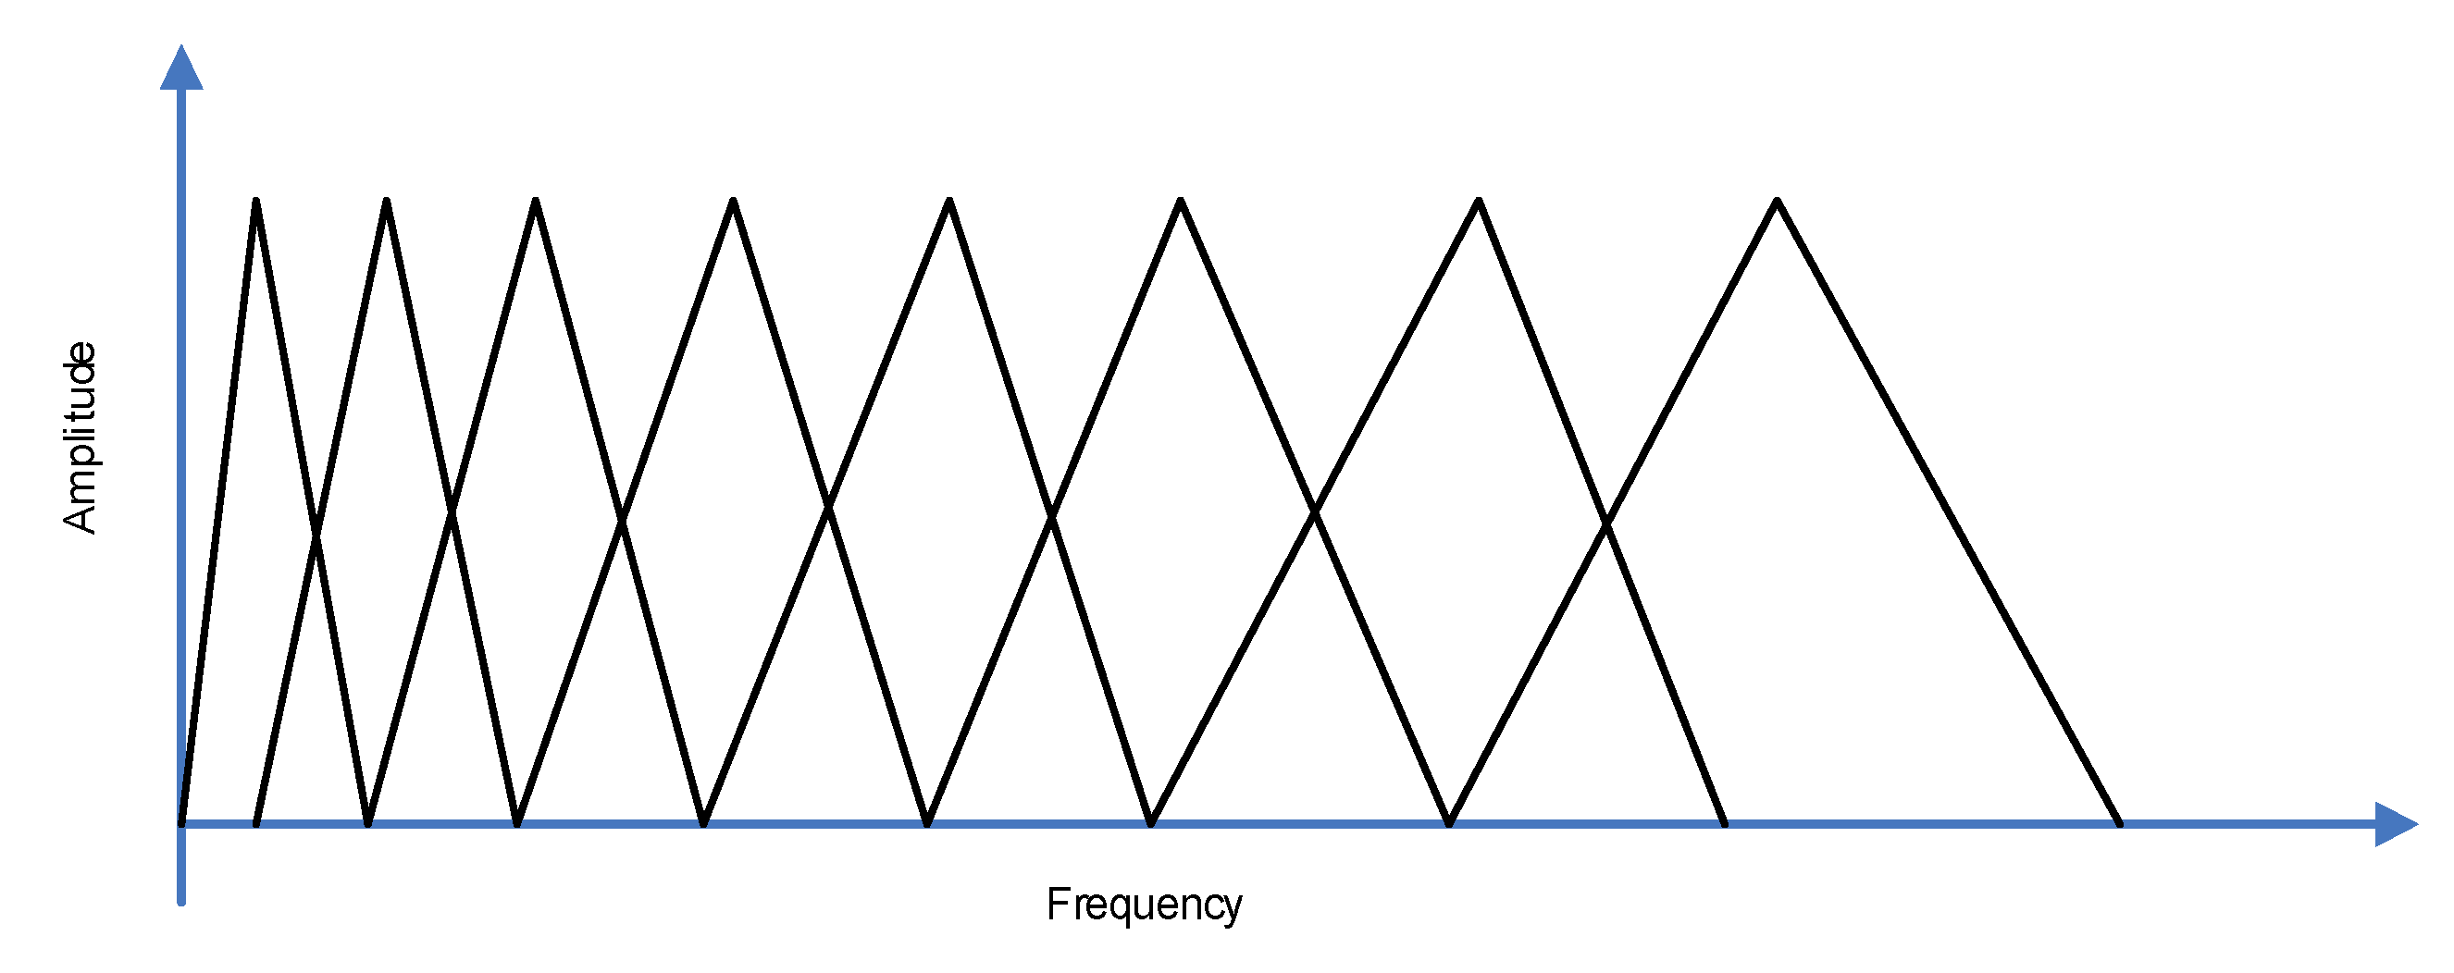
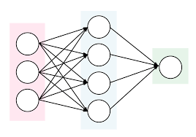
Complete Process
Project Achievement
Frequency domain
Mel
Filter banks
Frame
FFT
Mel Filtering
DCT
MFCCs
features of signal
Obtain highly distinguishable features
Network
Features(input)
target
8

Slide 9
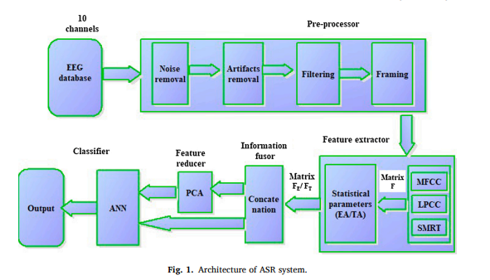
MFCC
EEG based direct speech BCI system using a fusion of SMRT and MFCC/LPCC features with ANN classifier
Based on dataset Kara One
Direct speech BCI
highest average recognition rate as 83.34%
9

Slide 10
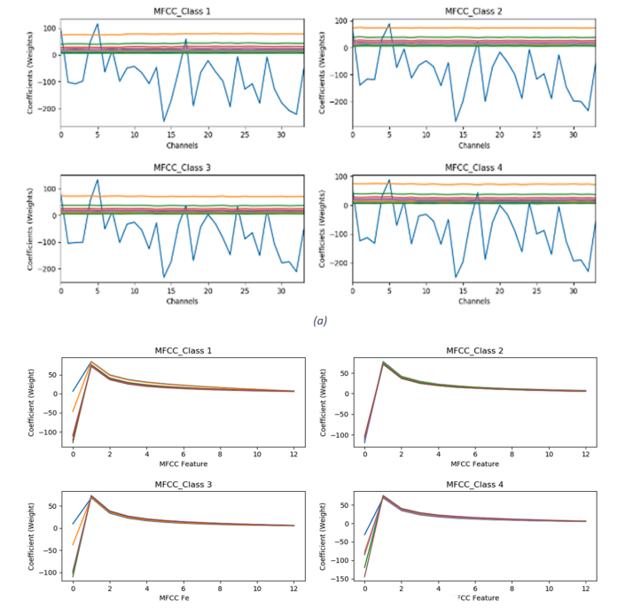
MFCC
Improving classification performance of four class FNIRS-BCI using Mel Frequency Cepstral Coefficients (MFCC)
Based on Open Access Dataset for EEG+NIRS Single-Trial Classification
Movement prediction
average classification accuracy of 90.54%
10

Slide 11
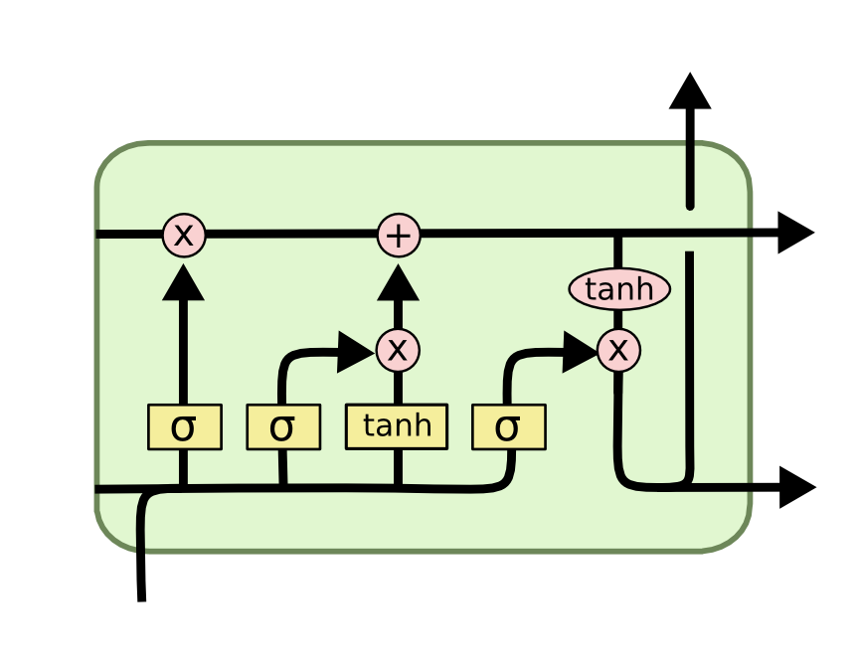
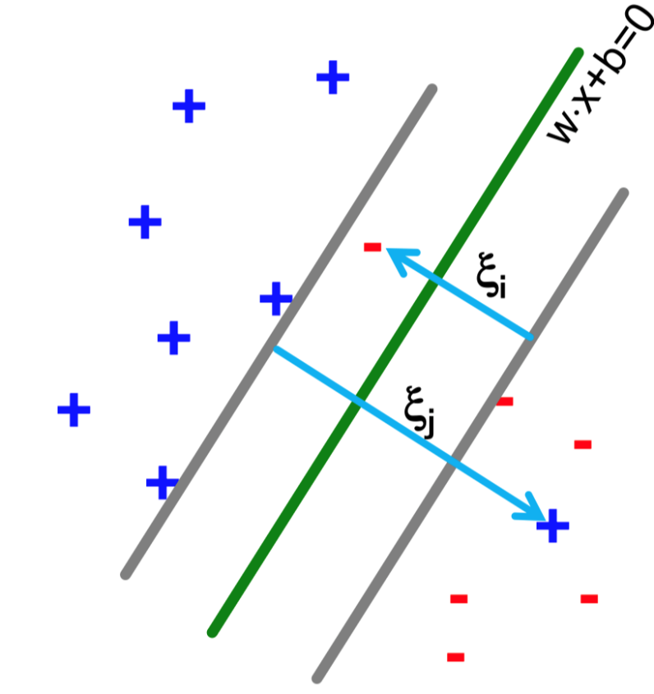
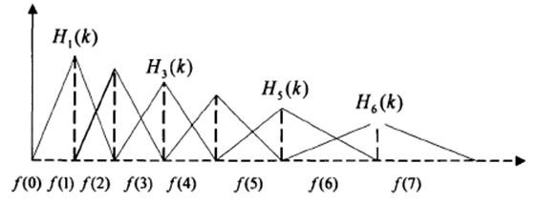
Development
Regression
KNN
SVM
2010
GLM
2017
ANN
2004
More Deep
Learning
SVM+ANN
2013
CNN、RNN
2017-2020
MFCC
2021
LDA
2013
Machine Learning
Deep Learning
11

Slide 12
Reference
Project Achievement
P.P. Mini, Tessamma Thomas, R. Gopikakumari, EEG based direct speech BCI system using a fusion of SMRT and MFCC/LPCC features with ANN classifier, Biomedical Signal Processing and Control, Volume 68, 2021, 102625, ISSN 1746-8094
Muhammad Saad Bin Abdul Ghaffar, Umar S. Khan, J. Iqbal, Nasir Rashid, Amir Hamza, Waqar S. Qureshi, Mohsin I. Tiwana, U. Izhar, Improving classification performance of four class FNIRS-BCI using Mel Frequency Cepstral Coefficients (MFCC), Infrared Physics & Technology, Volume 112, 2021, 103589, ISSN 1350-4495
Development（see attached files）
12

